Slide 1



LEAD Myself
Personal Effectiveness
Time Management

Slide 2
LEAD Myself
LEAD MYSELF - PERSONAL EFFECTIVENESS
 | Pre-workshop study | Programme Objectives
Awareness and management of self and others | Managing your time strategically | To optimise the relationship between efficiency and effort To prioritise events according to their level of importance
 | Clarifying and managing your priorities | To identify obstacles to excellent time management
 | Understand how you deal with stress | To identify how you deal with stress and its consequences on the organisation and your work
 | Knowing yourself better to communicate better | To develop self-knowledge for better communication
Notes:
Need to check review these.

Slide 3

LEAD Myself – Time Management
“Time management” is the process of organizing and planning how to divide your time between specific activities. Good time management enables you to work smarter – not harder – so that you get more done in less time, even when time is tight and pressures are high. Failing to manage your time damages your effectiveness and causes stress.
Notes:
Need to check review these.

Slide 4

LEAD Myself – Time Management
Benefits of Time Management
Greater productivity and efficiency.
A better professional reputation.
Less stress
Increased opportunities for advancement.
Greater opportunities to achieve important life and career goals.
Notes:
Need to check review these.

Slide 5

LEAD Myself – Time Management
How Do Your Management Skills Stack Up?
Take the time management test to find out how effective you are in managing your time
Refer to How is Your Time Management Test in the materials (pdf format)
Notes:
Need to check review these.

Slide 6
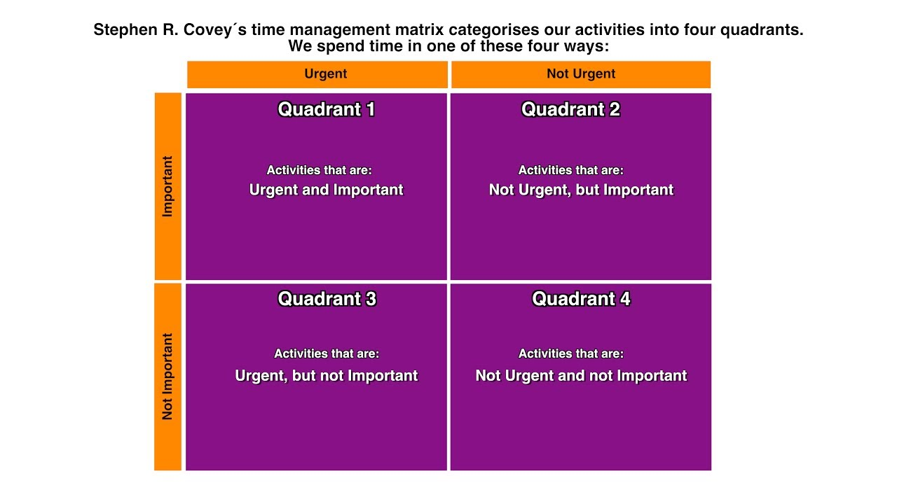
LEAD Myself – Time Management
Covey’s Time Management Matrix Tool
Refer to the article by Steve Mueller: Covey’s Time Management Matrix Explained
Notes:
Need to check review these.

Slide 7
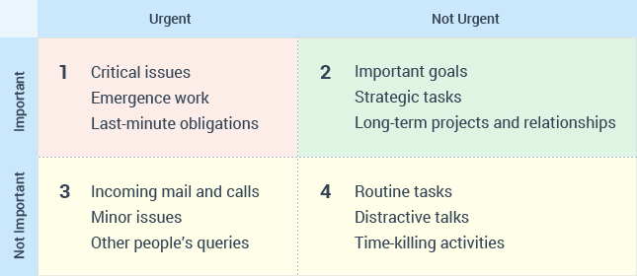
LEAD Myself – Time Management

Slide 8

LEAD Myself – Time Management
Common Time Management Mistakes
Failing to Keep a To-Do List
Not Setting Personal Goals
Not Prioritizing
Failing to Manage Distractions
Procrastination
Taking on Too Much
Thriving on "Busy"
Multitasking
Not Taking Breaks
Ineffectively Scheduling Tasks
Notes:
Need to check review these.

Slide 9
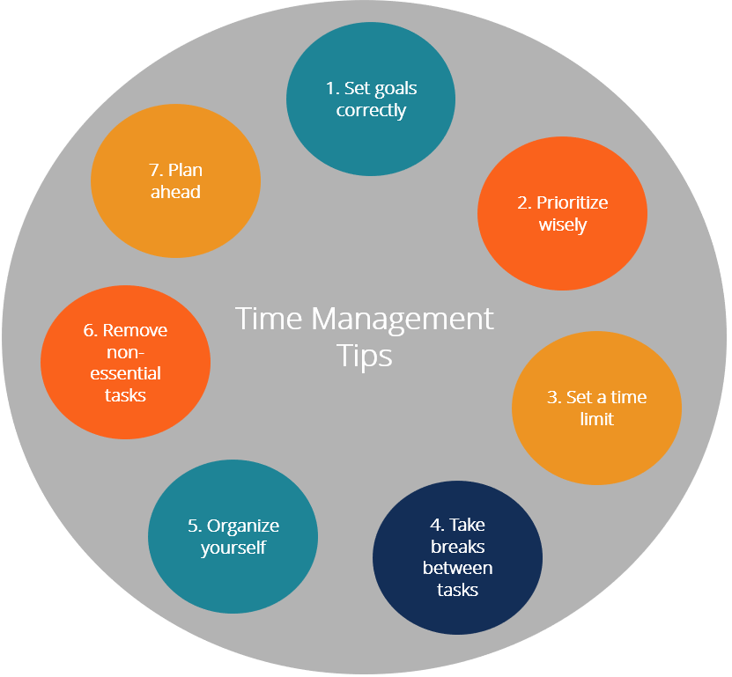
LEAD Myself – Time Management
Notes:
Need to check review these.

Slide 10
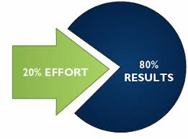
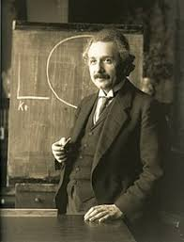
LEAD Myself – Time Management
Managing your time wisely
1 Use the 80/20 Rule
2. Find Your Einstein Window
3. Communicate Your Availability
4. Protect Your Window
Watch the videos by Tom Dewett (LinkedIn) – 11 mins
Notes:
Need to check review these.

Slide 11
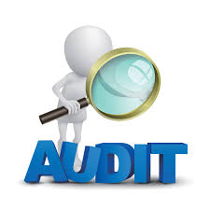
LEAD Myself – Time Management
Time Management Audit
It’s important to keep track of time, because it’s often the resource we
have in shortest supply. Taking stock of your time will enable you to decide where
best to allocate the precious hours you have.
In this Bite-Sized Training™ session, we’ll explore how you can do this. Since you
can’t increase the number of hours in your day, you need to be diligent about
tracking and optimizing the time you have.
In this session, you will:
• Complete an Activity Log, so that you can track exactly what you do.
• Analyze the types of activities that take up most of your time.
• Create a system to manage your inbox effectively
Do Time Management Audit Bite-Sized Training (refer to Time Management Audit PDF)
Notes:
Need to check review these.

